Slide 1

Contact Person(s):
ROBERTO E. JOMEN III - rejomen@gmail.com
JUVELYN L. JOMEN - juvielagamonjomen@gmail.com

Slide 2
GinPRA is a partner of Rotary Burwood Australia directly coordinating with PP Walter Bock, OAM and PP Peter Hamer on the distribution of the DIK goods in Gingoog City – Northern Mindanao, Philippines.
We are a group of young individuals who voluntarily facilitated the unloading, storing, sorting and distribution of DIK goods to respective beneficiaries.
Apart from the disaster relief goods, the hospital and school equipment, we have already distributed thousands of bras to the less fortunate women in the mountain villages of Gingoog; and to the victims of the calamities like typhoon Sendong that hit Cagayan de Oro in 2011, victims of typhoon Pablo that hit Davao Oriental in 2012, and to the victims of typhoon Yolanda that recently hit Tacloban and other areas in Visayas. This program benefited around 6 thousand women with minimum of 4 bras each woman.
This project greatly helps women who cannot afford to buy and have descent bras due to the very expensive bras available in the market. With the continuing increase of commodities today, and very low income earned by majority of the families here, to buy a bra would be the last priority.
In behalf of the beneficiaries, we sincerely thanks Project Uplift. We are looking forward for a continuing partnership to bring your aid to those who are in need.

Slide 3
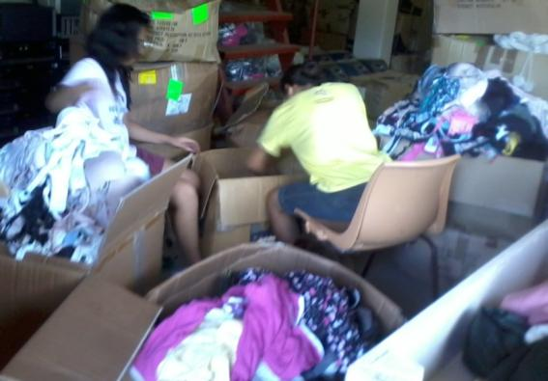
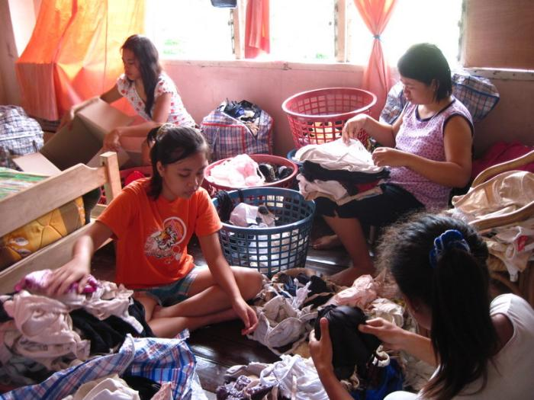
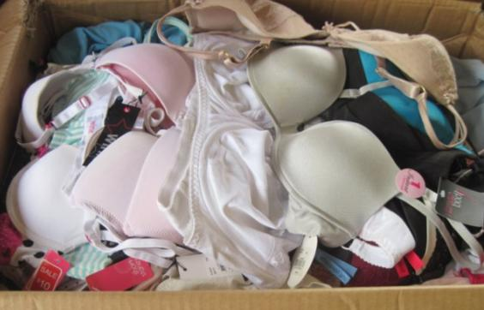
SORTING & PACKING
Young volunteers sorting and segregating the bras according to its quality and sizes making them ready for packing and distribution.

Slide 4
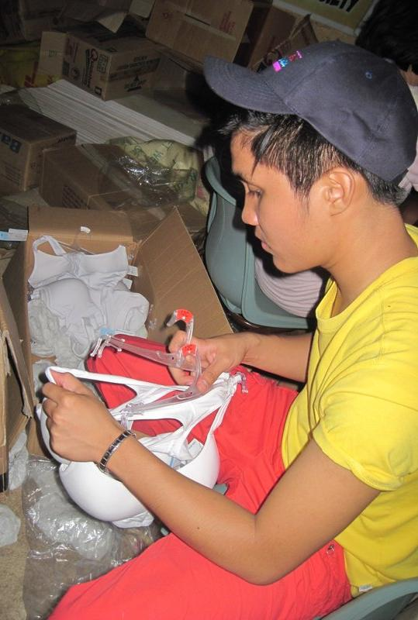
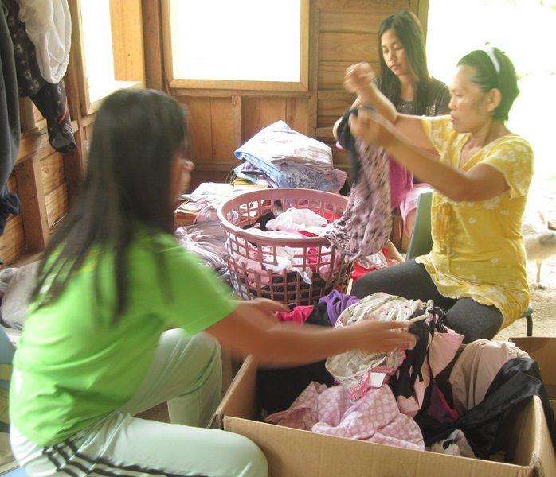
SORTING & PACKING

Slide 5
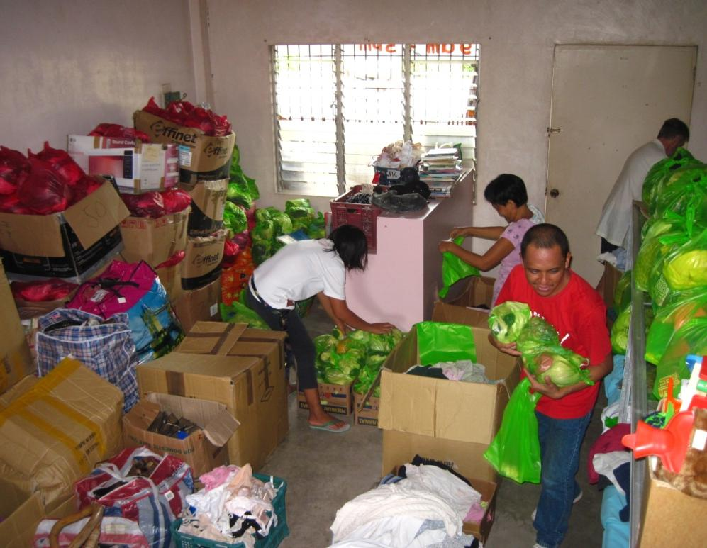
SORTING & PACKING

Slide 6
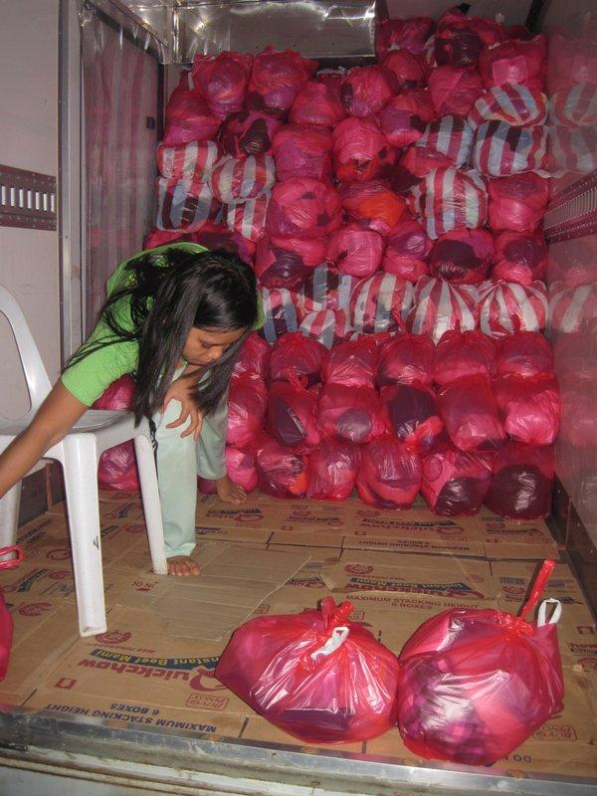
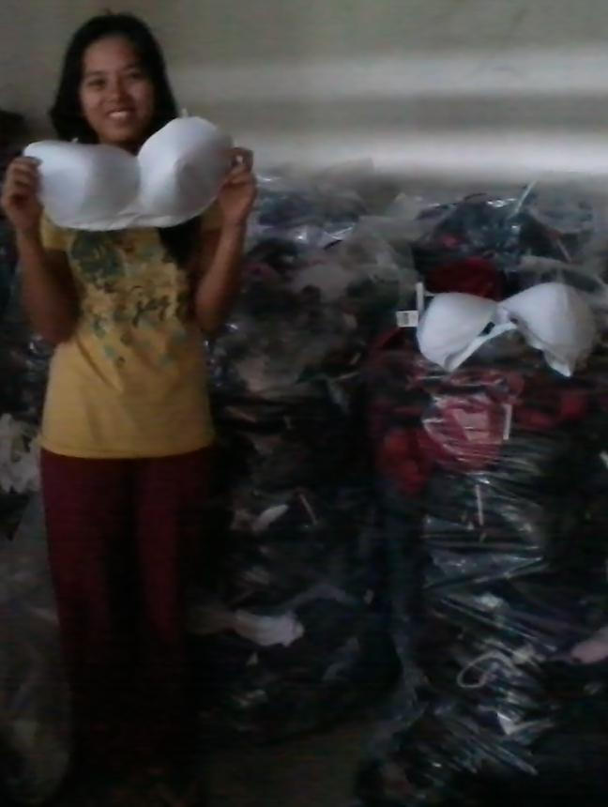
SORTING & PACKING

Slide 7
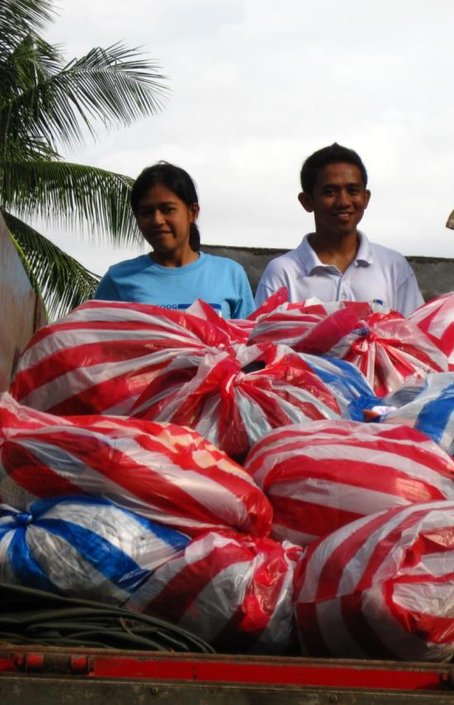
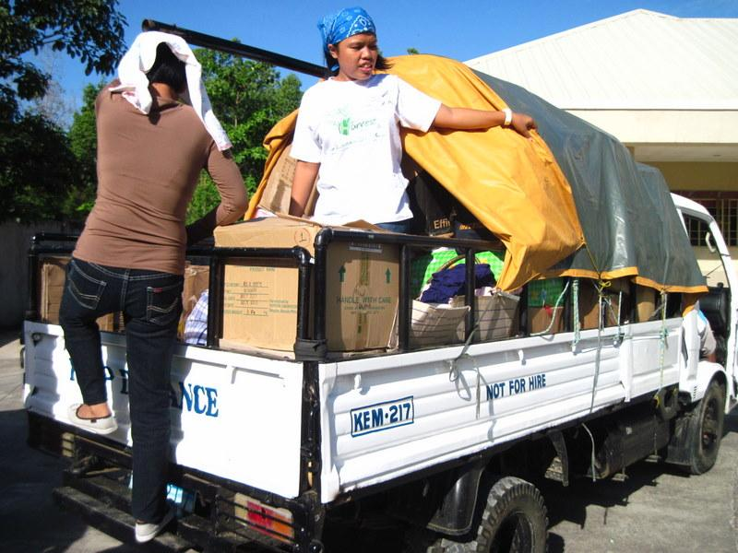
DISTRIBUTION – Gingoog Mountain Villages

Slide 8
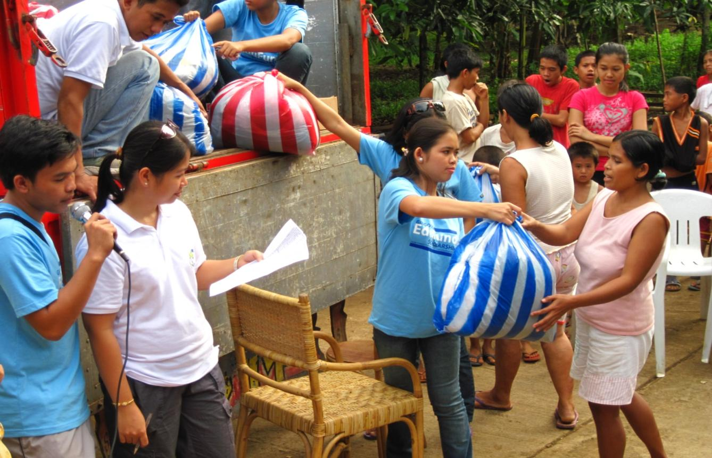
DISTRIBUTION – Gingoog Mountain Villages

Slide 9
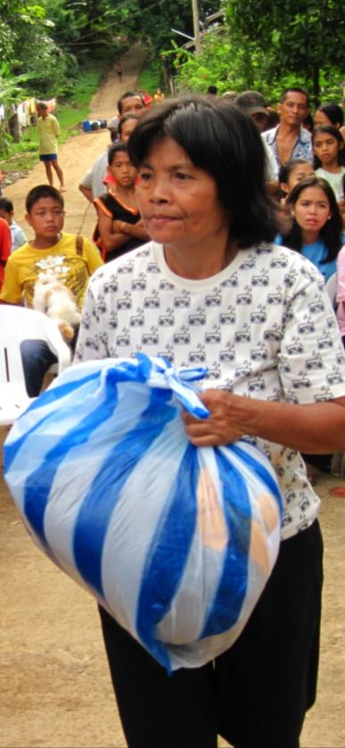
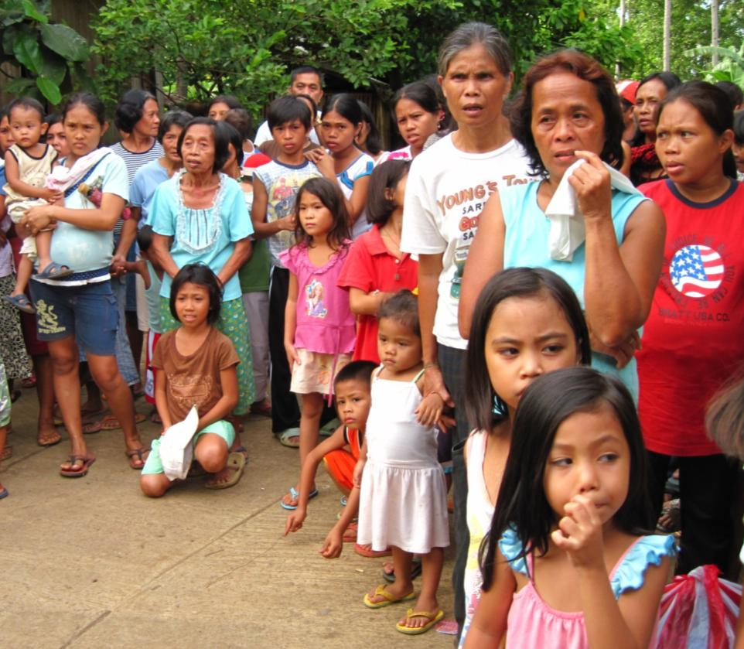
DISTRIBUTION – Gingoog Mountain Villages

Slide 10
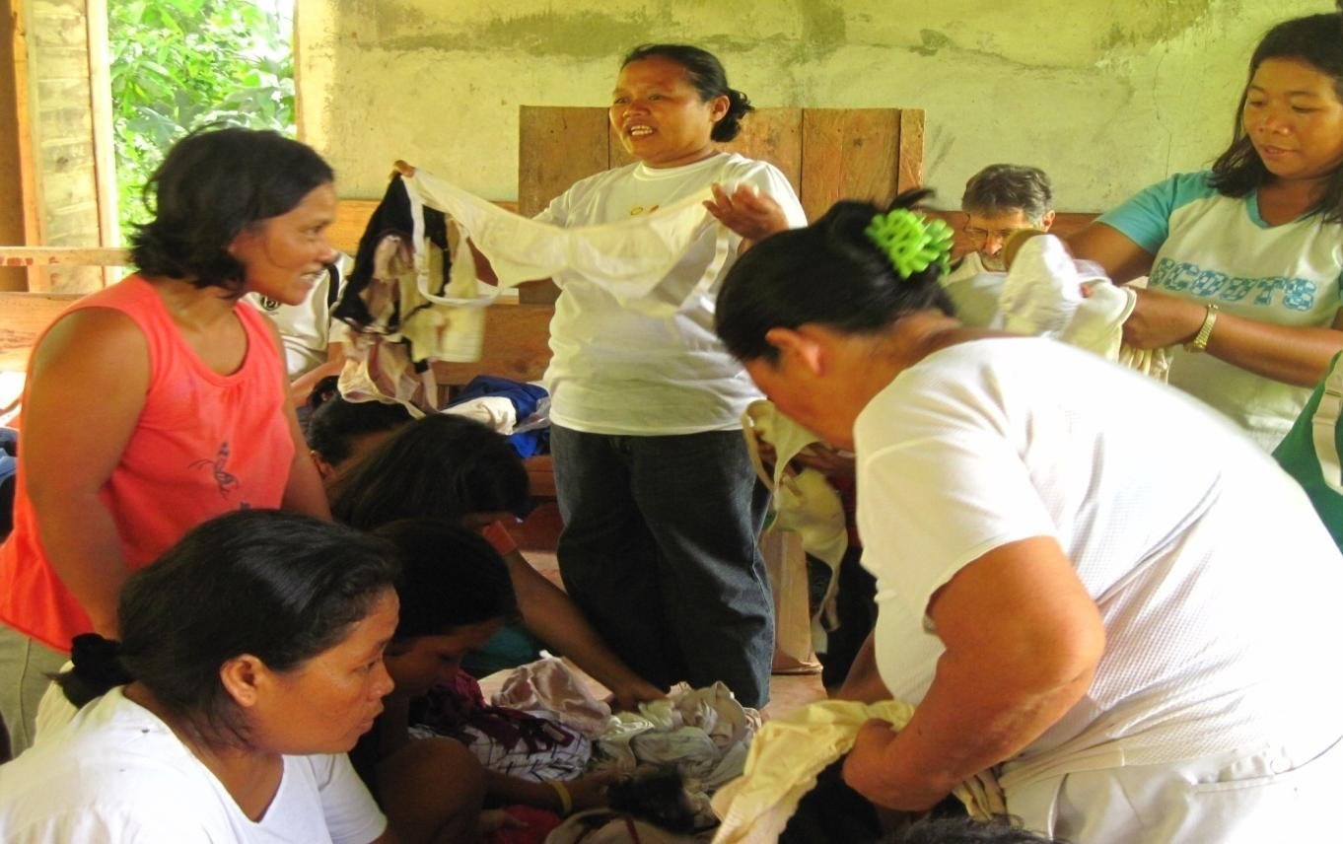
DISTRIBUTION – Gingoog Mountain Villages

Slide 11
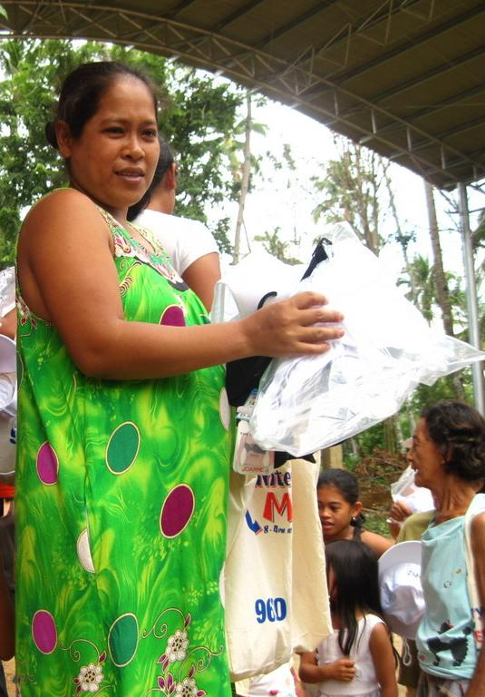
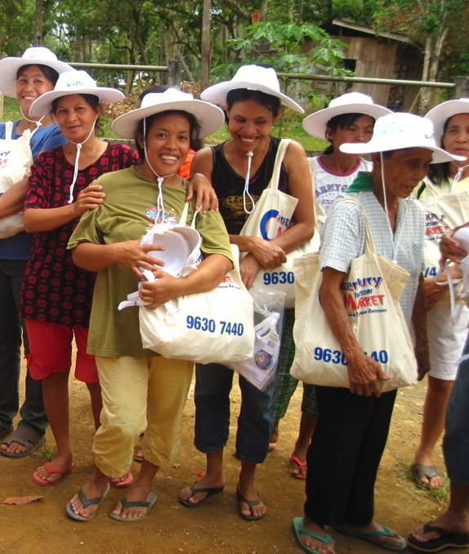
DISTRIBUTION – Gingoog Mountain Villages

Slide 12
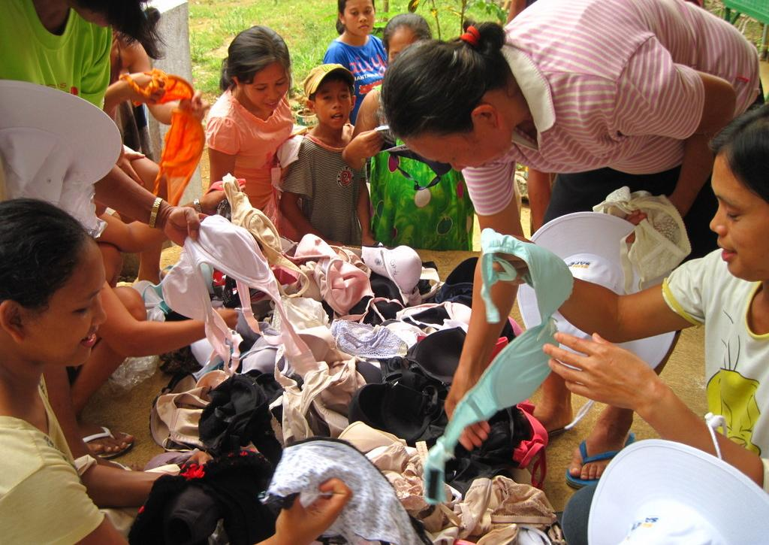
DISTRIBUTION – Gingoog Mountain Villages

Slide 13
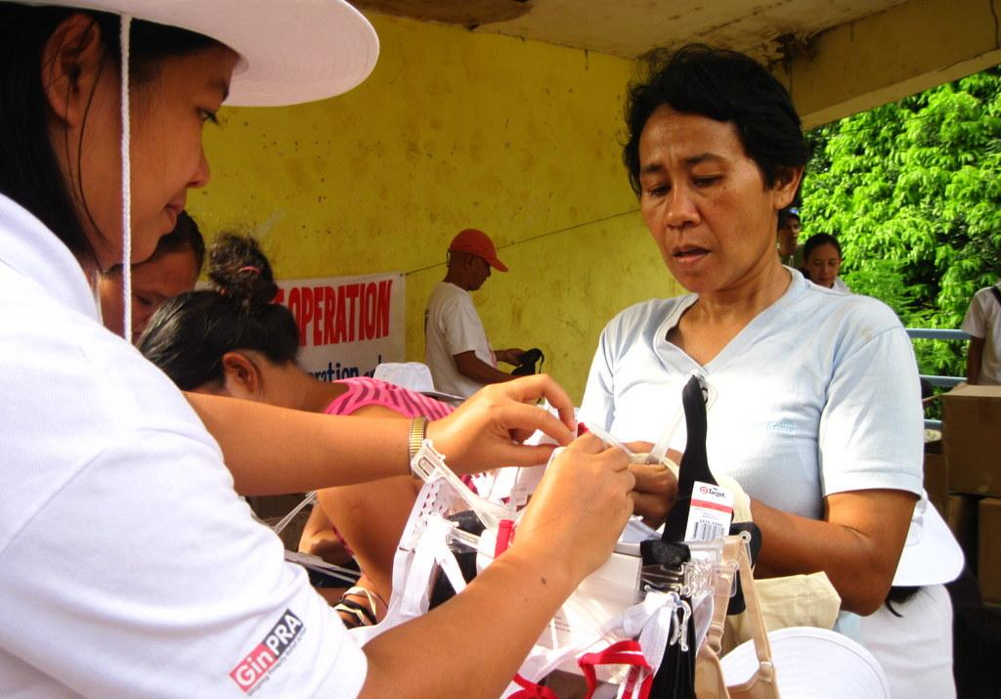
DISTRIBUTION – Gingoog Mountain Villages

Slide 14
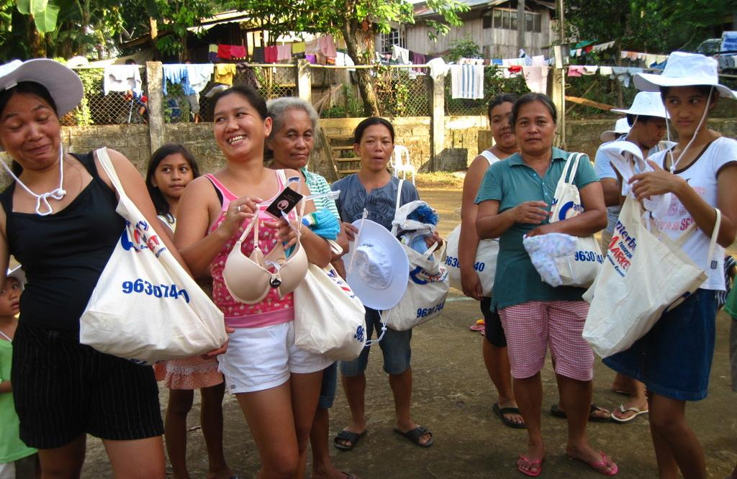
DISTRIBUTION – Gingoog Mountain Villages

Slide 15
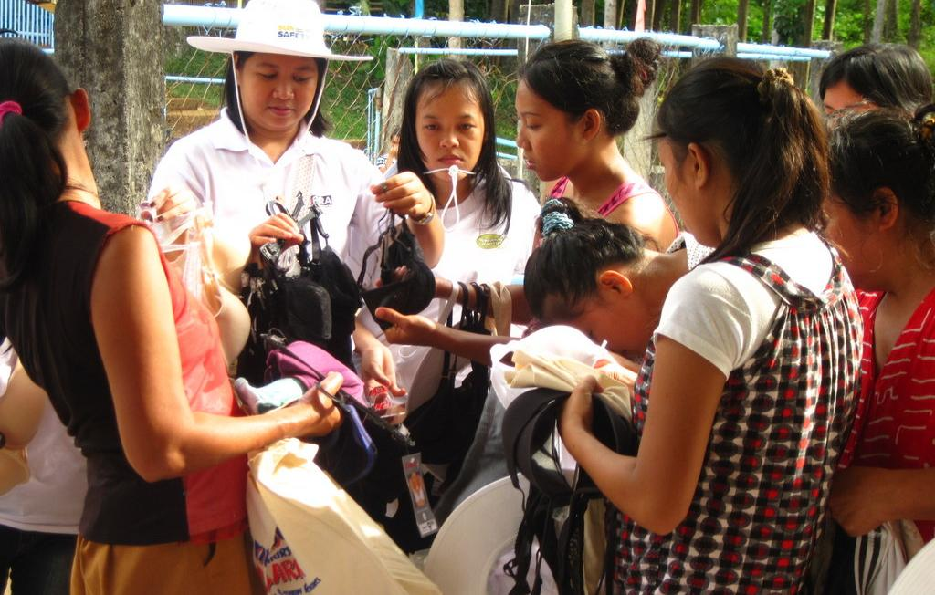
DISTRIBUTION – Gingoog Mountain Villages

Slide 16
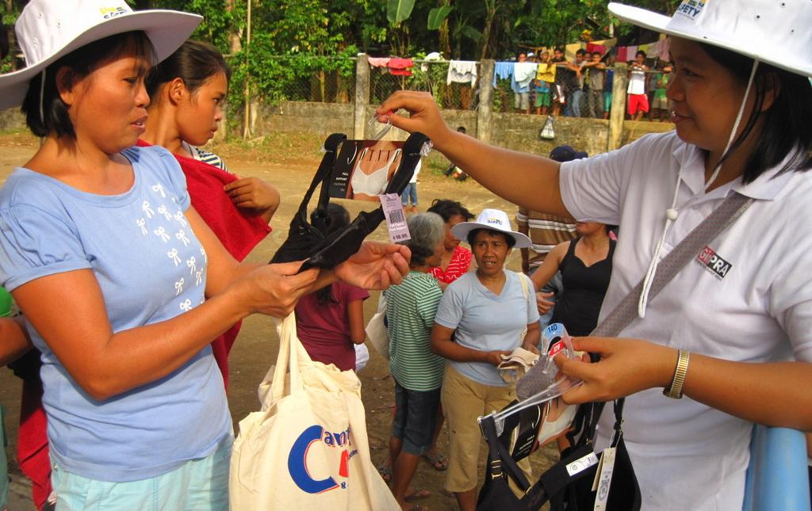
DISTRIBUTION – Gingoog Mountain Villages

Slide 17
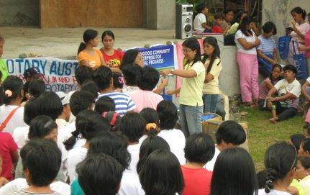
DISTRIBUTION – Gingoog Mountain Villages

Slide 18
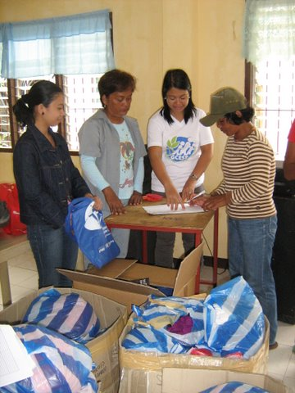
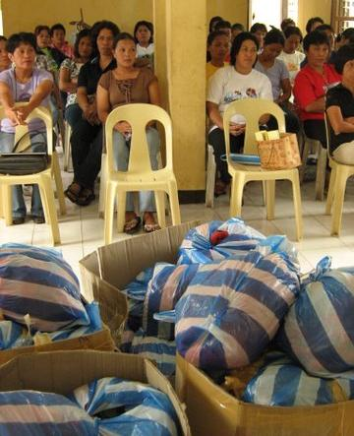
DISTRIBUTION – Gingoog Mountain Villages

Slide 19
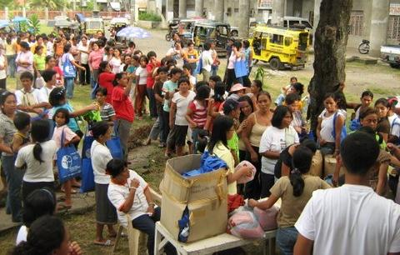
DISTRIBUTION – Gingoog Mountain Villages

Slide 20
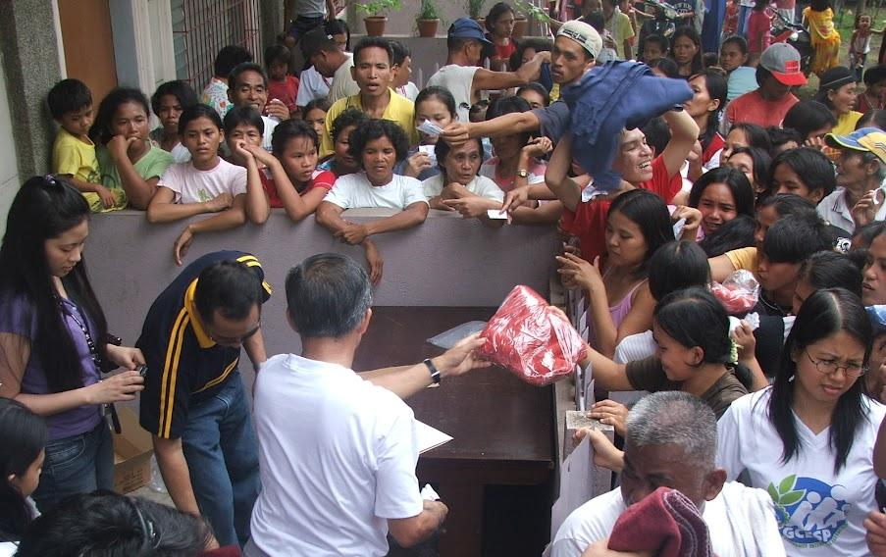
DISTRIBUTION – Gingoog Mountain Villages

Slide 21
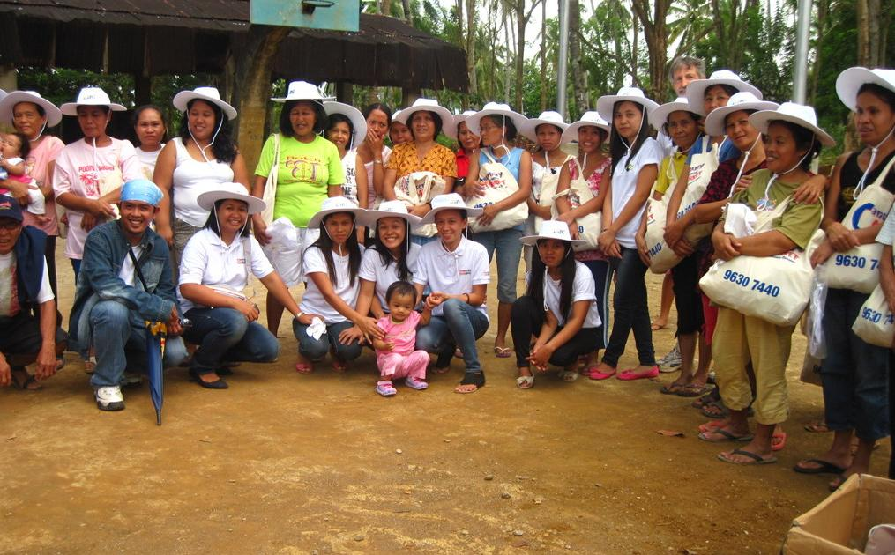
DISTRIBUTION – Gingoog Mountain Villages

Slide 22
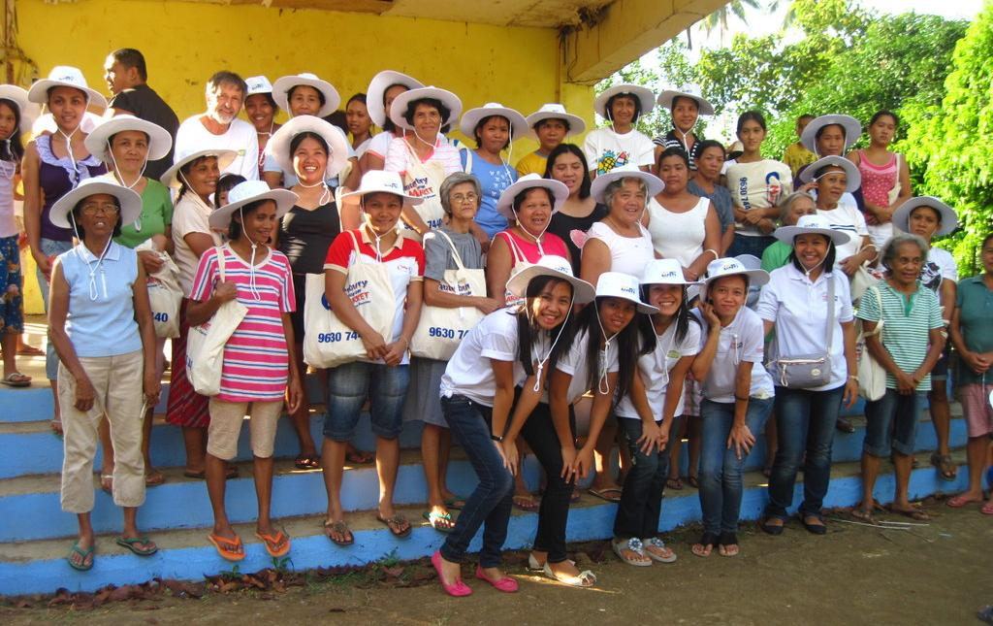
DISTRIBUTION – Gingoog Mountain Villages

Slide 23
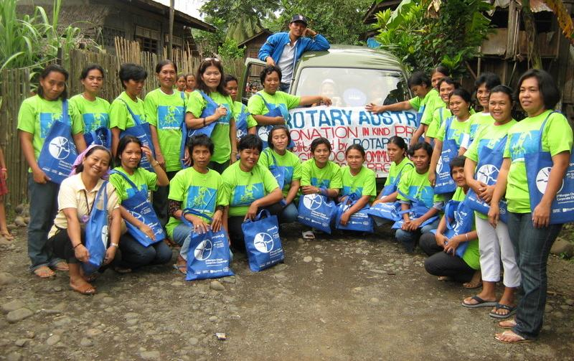
DISTRIBUTION – Gingoog Mountain Villages
Along with the bras distributed were t-shirts, magazine, and bag.

Slide 24
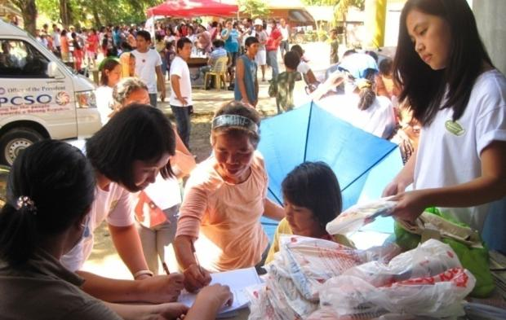
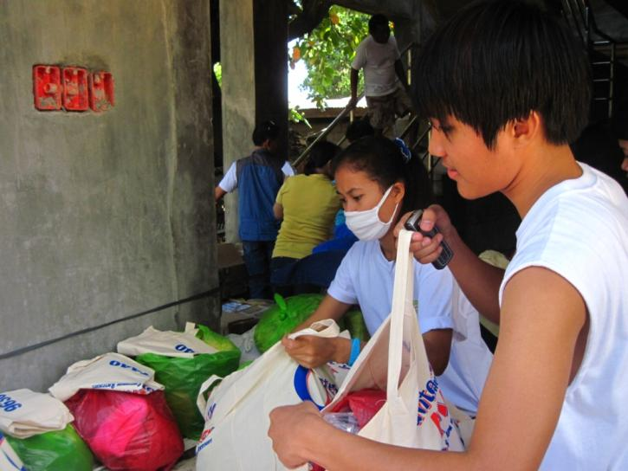
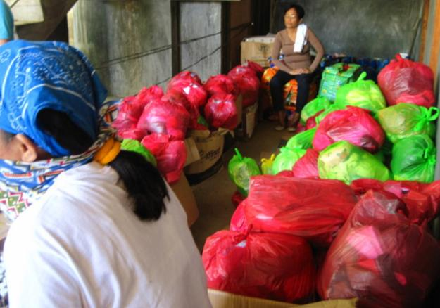
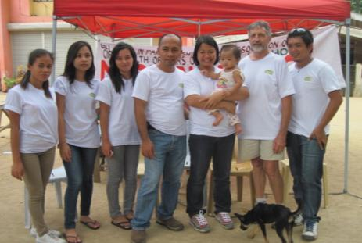
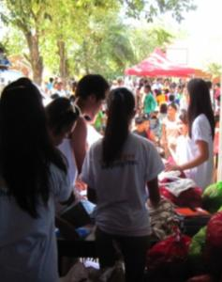
DISTRIBUTION
TYPHOON WASHI VICTIMS - CAGAYAN DE ORO CITY

Slide 25
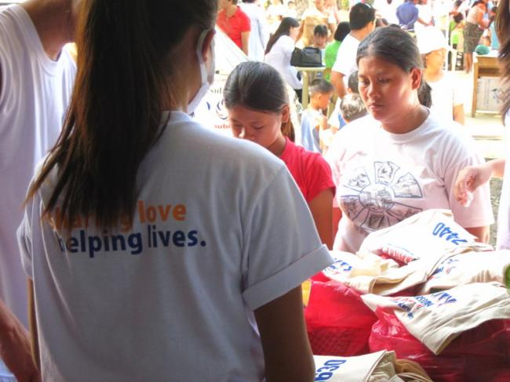
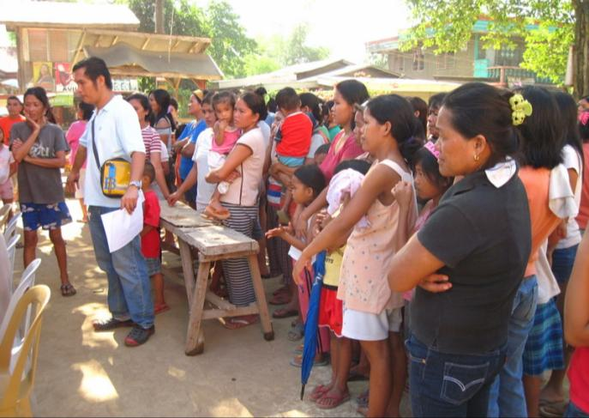
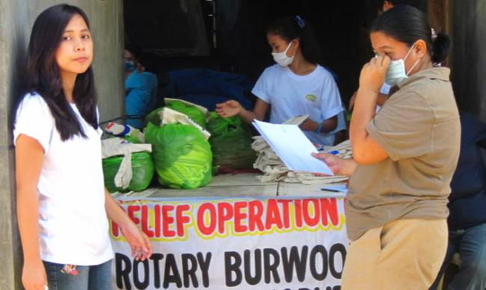
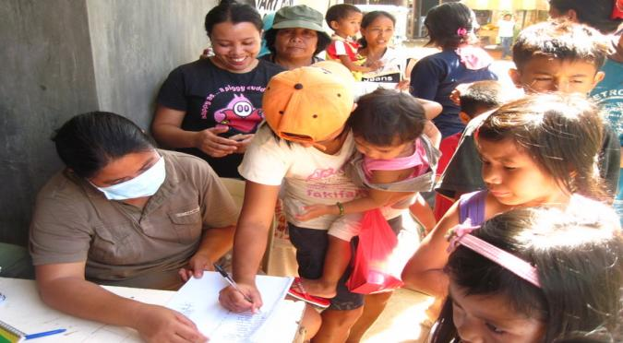
DISTRIBUTION
TYPHOON WASHI VICTIMS - CAGAYAN DE ORO CITY

Slide 26
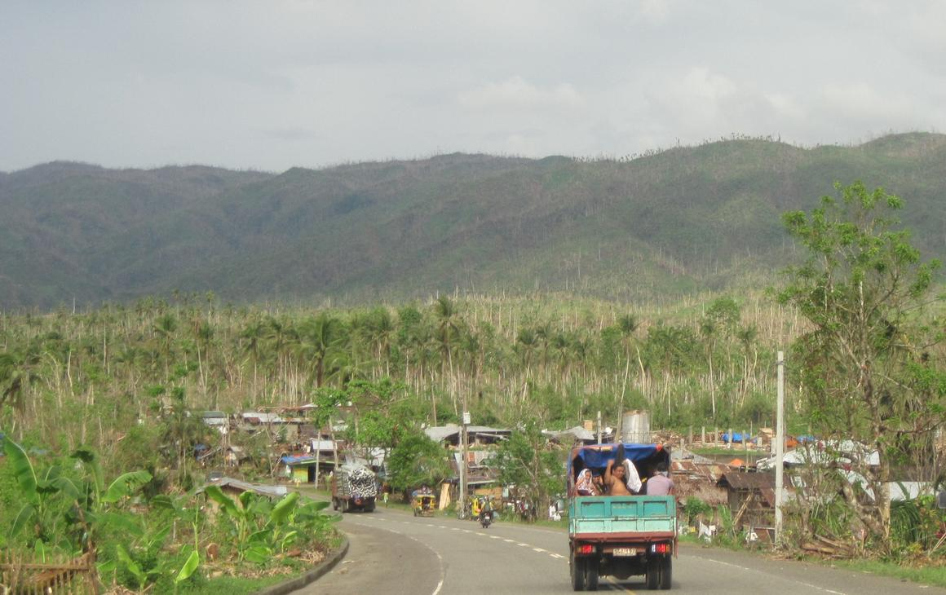
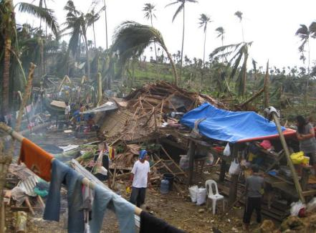
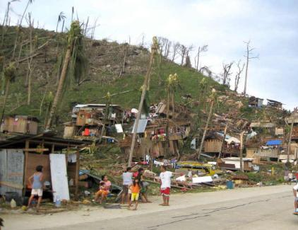
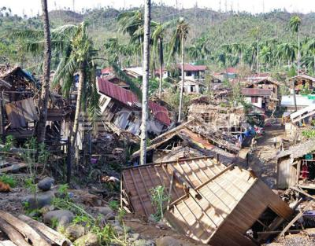
DISTRIBUTION
TYPHOON BOPHA VICTIMS - DAVAO ORIENTAL

Slide 27
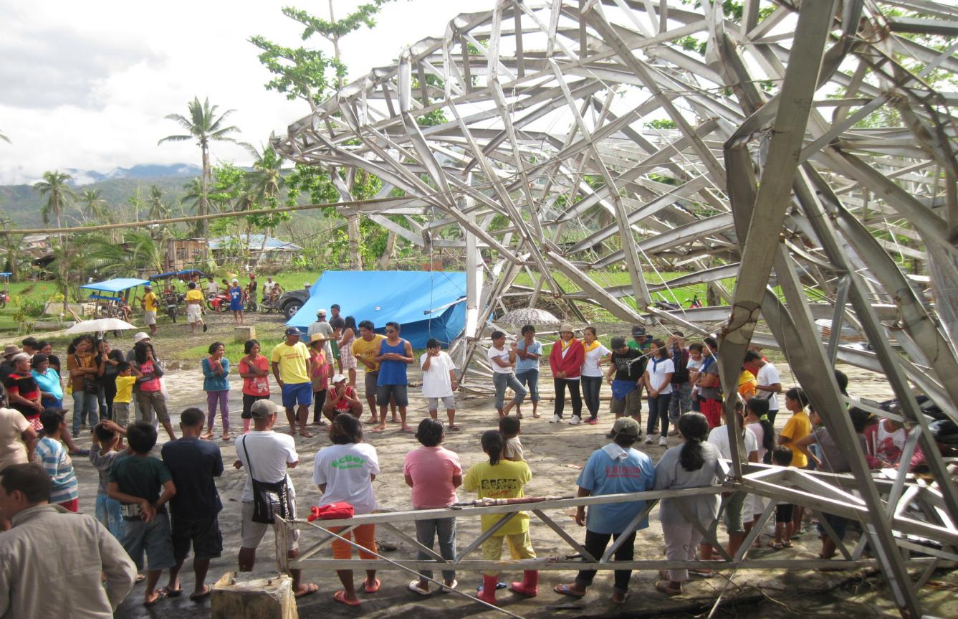
DISTRIBUTION
TYPHOON BOPHA VICTIMS - DAVAO ORIENTAL

Slide 28
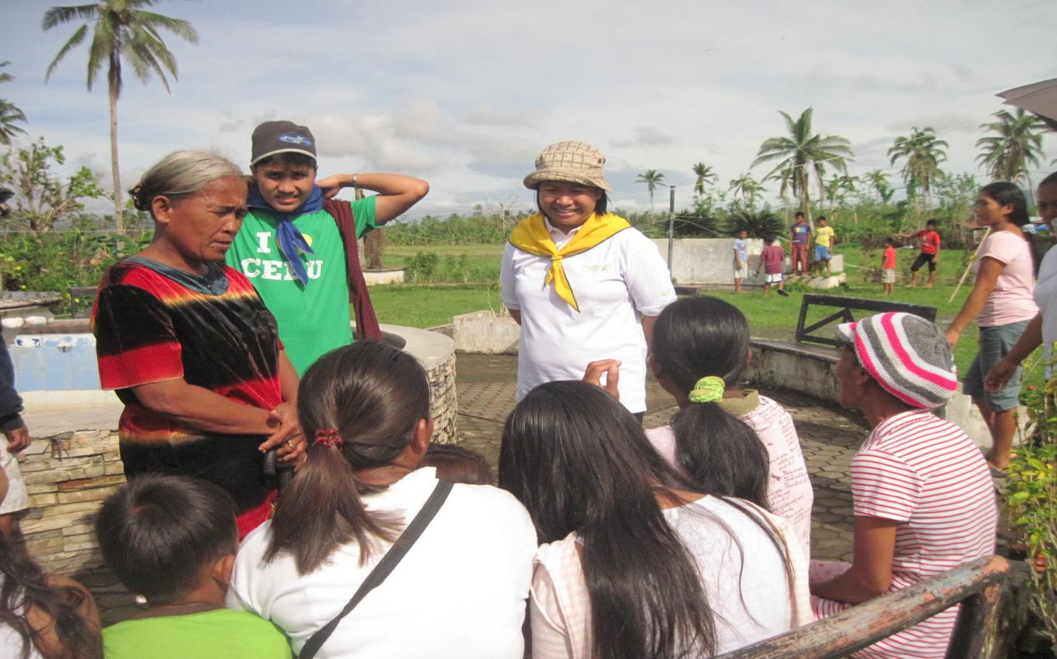
DISTRIBUTION
TYPHOON BOPHA VICTIMS - DAVAO ORIENTAL

Slide 29
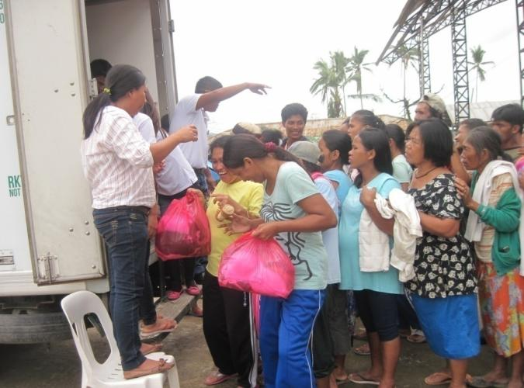
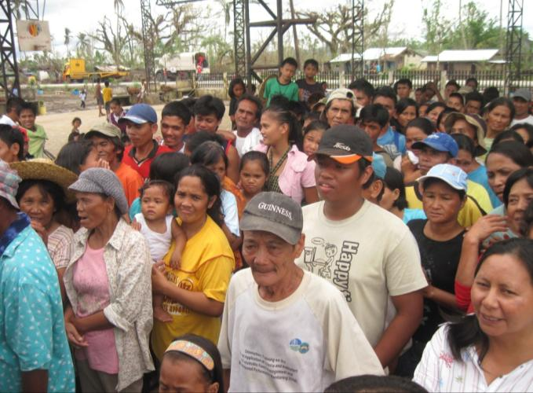
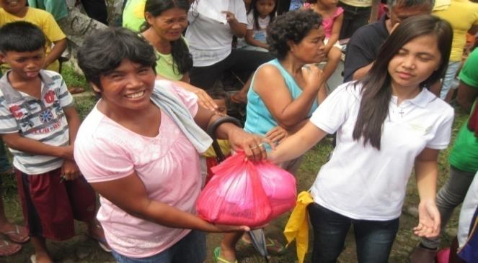
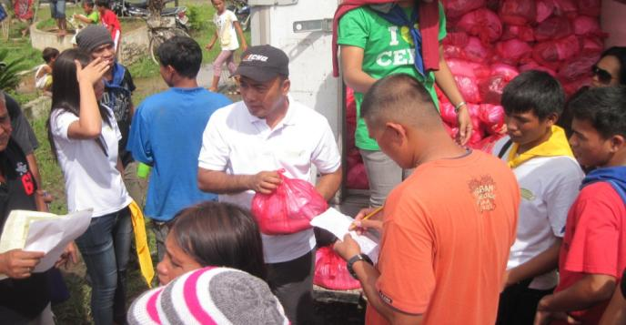
DISTRIBUTION
TYPHOON BOPHA VICTIMS - DAVAO ORIENTAL

Slide 30
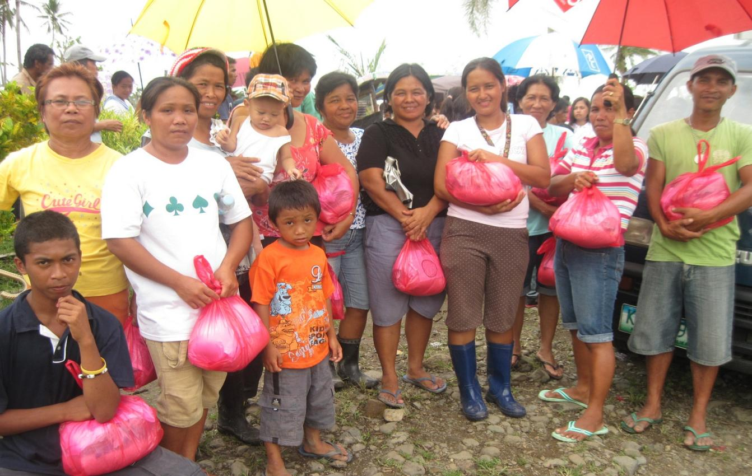
DISTRIBUTION
TYPHOON BOPHA VICTIMS - DAVAO ORIENTAL

Slide 31
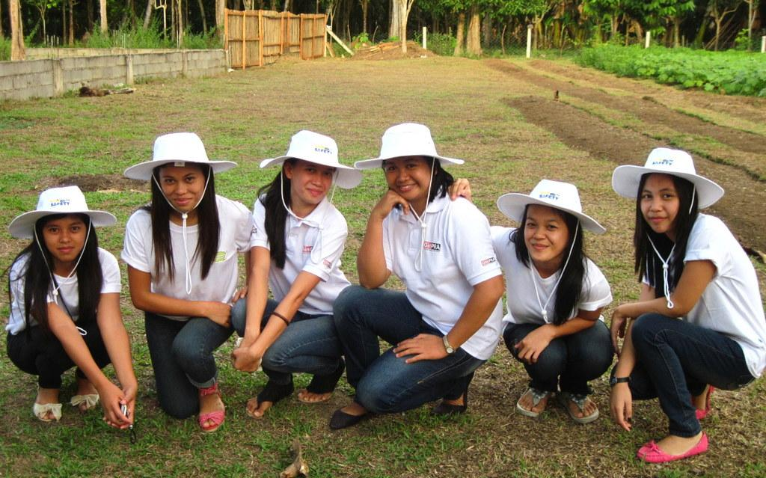
Our warm regards to the Project Uplift Administrators.
Thank You!

